Slide 1
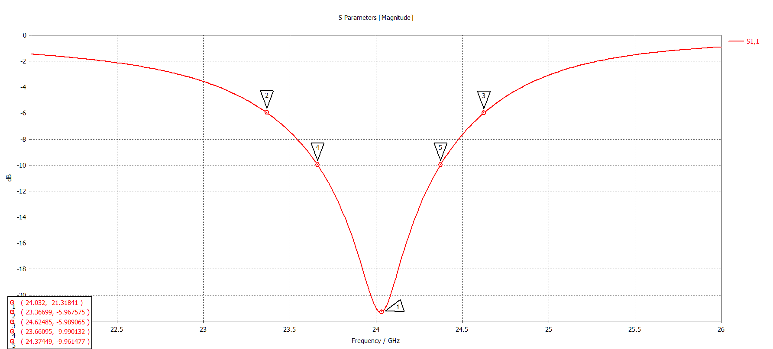
1D Results\S-Parameters\S1,1

Slide 2
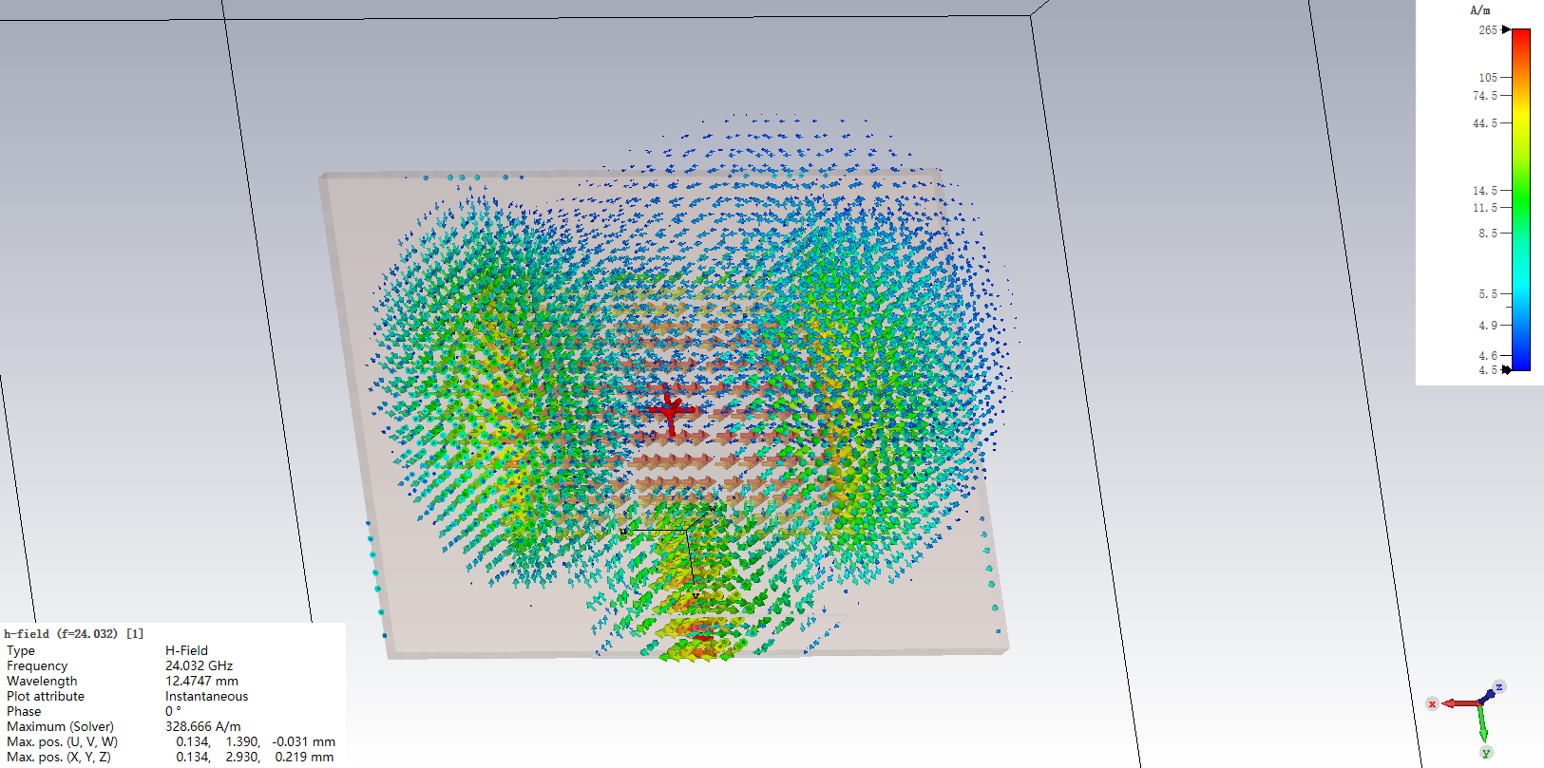
2D/3D Results\H-Field\h-field (f=24.032) [1]

Slide 3
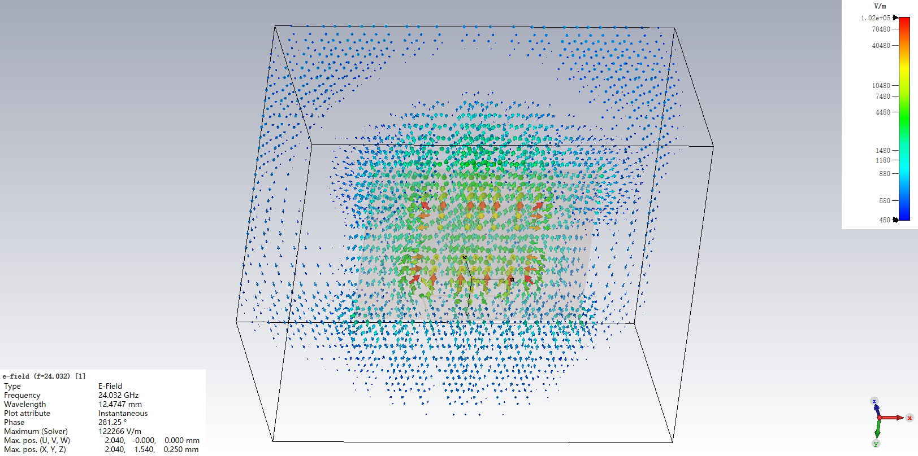
2D/3D Results\E-Field\e-field (f=24.032) [1]

Slide 4
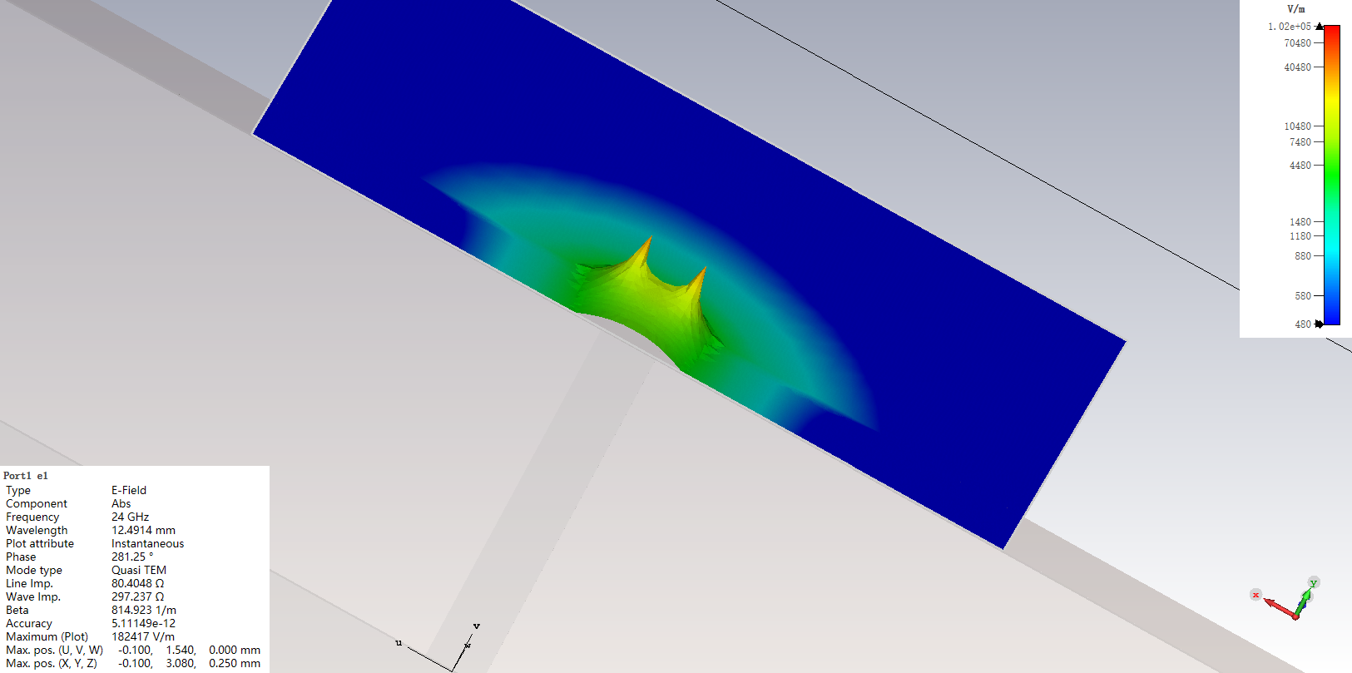
2D/3D Results\Port Modes\Port1\e1

Slide 5
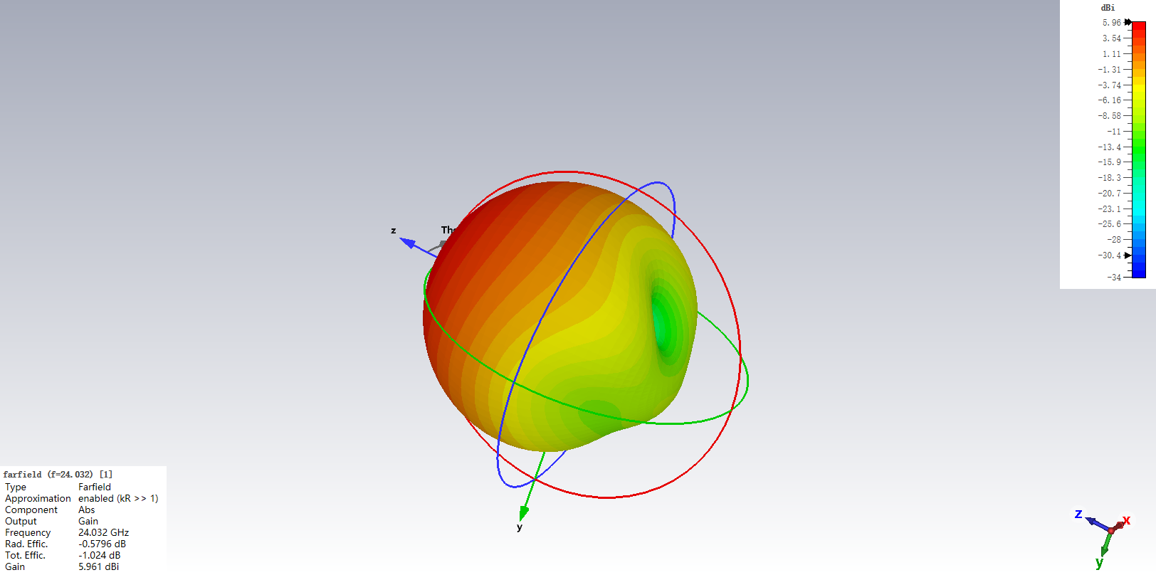
Farfields Gain

Slide 6

Farfields Directivity

